Slide 1


Gym Presentation Template
BUILD & PRICE TOOL TRAINING
Spring 2022
Notes:
Title slide option 1.
NOTE: Headline font throughout presentation is called Raleway. If you don’t have it downloaded on the computer you’re using, download it here for free: https://fonts.google.com/specimen/Raleway. Then install the fonts onto your computer to ensure they present properly.

Slide 2
Introduction
The SurePoint Ag Build and Price Tool is currently aimed at quoting “typical”, single-product fertilizer systems on 30” spacing John Deere planters. If your configuration is atypical, or the options presented don’t allow for the type of system you’d like quoted, please fill out a quote request form at www.surepointag.com/quote-request or contact a SurePoint Ag sales representative at (866) 626-3670.
Upon conversion to order in the Build and Price Tool, a SurePoint Ag sales rep will review the order to verify components and completeness. They will then contact you to go over some specifics to finalize the order.
Component pricing in the Build and Price Tool is updated nightly, so some minor changes may occur. Pricing will also be affected if the SPA sales rep determines that component tweaks need to be made before conversion to order.

Slide 3
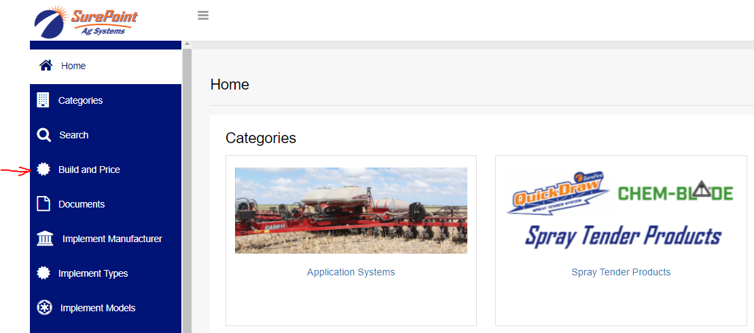
Accessing the Configurator
Go to support.surepointag.com. Login using the dropdown menu in the upper right, or select “Request Dealer Access” if you’re a new user (new users will need to fill out the form and it will then be subject to approval before your account is activated).
Once logged in, select “Build and Price” from the left-hand menu.

Slide 4
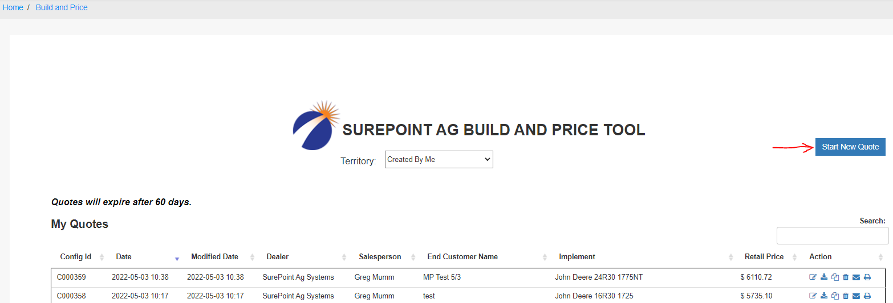
Starting a New Quote
This will bring up the quote / order listing page. We’ll return to this page later. Click the blue “Start New Quote” button in the upper right to begin a quote.

Slide 5


Entering System
Data

Slide 6
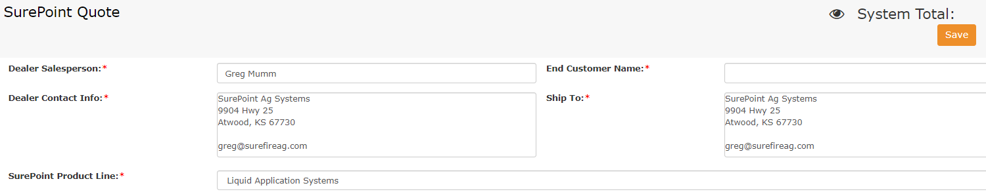
Data Entry (Part 1)
All fields with a red asterisk (*) are required.
The Dealer name and Dealer Contact Info fields will populate with your information.
Enter the End Customer Name if available, or type something like “unknown” or “generic quote”.
The Ship To field will populate with the same info as your dealer contact info but can be edited if it will ship elsewhere.
SurePoint Product Line defaults to Liquid Application Systems (more product lines will be offered in the Build and Price Tool at a later date).

Slide 7
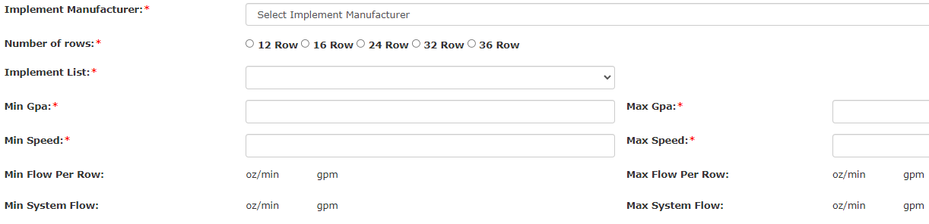
Data Entry (Part 2)
Select the Implement Manufacturer from the dropdown menu.
Select the correct Number of Rows.
The Implement List will then populate. Make a selection from the dropdown menu.
Enter the correct values for Min GPA, Max GPA, Min Speed, Max Speed. The system calculations will then be displayed below.

Slide 8
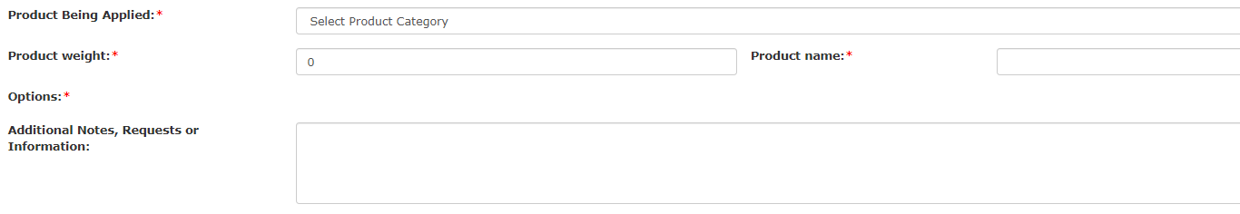
Data Entry (Part 3)
Select the correct category for the liquid being applied from the Product Being Applied dropdown menu.
Type in the weight of the fertilizer being applied in the Product Weight field.
Type in the Product Name of the fertilizer being applied (if not known, type unknown).
The information entered into the three product weight fields will be used by your SPA sales rep to determine metering tube sizing if the quote is converted to an order.
Reminder: All fields with an asterisk (*) need to be completed before the quote can be saved.

Slide 9
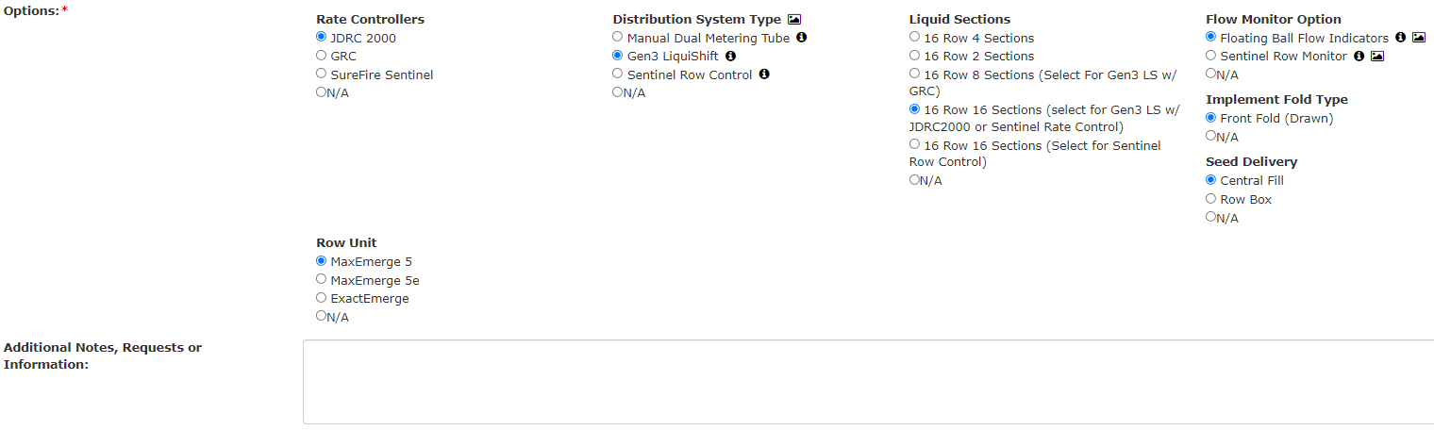
Data Entry (Part 4)
In the Options section, make a selection in each category. Additional information can be found for some items by clicking the picture icon ( ) or by hovering the mouse over the info icon ( ).
If there is any additional info that needs to be conveyed to SurePoint Ag about the system being quoted, type it in the Additional Notes, Requests, or Information field.

Slide 10
System Design

Slide 11
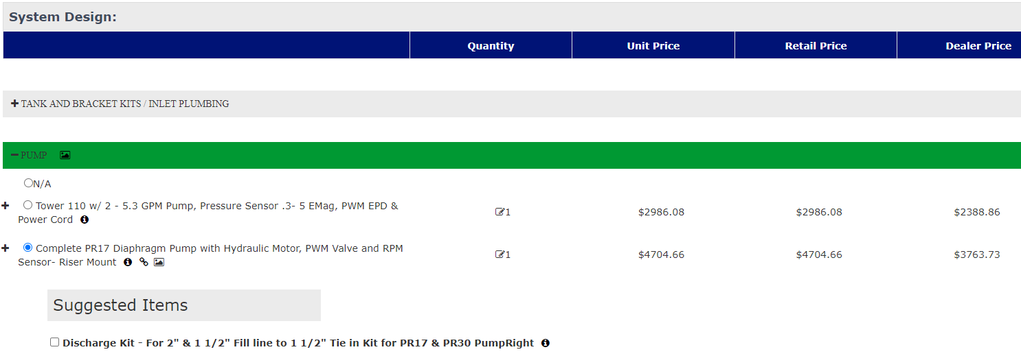
Selection of Components
The categories in the System Design section will change based upon the information entered and the Options selected. There may be a small delay before the correct categories are displayed. Make sure to select something from each category (select N/A if nothing is needed from a category). See the options under each category by hitting the “+” icon next to the category name. The category headings will turn green once a selection is made.

Slide 12
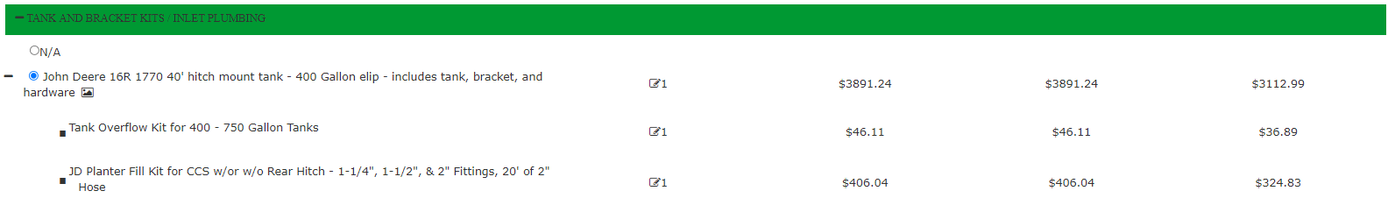
Connected Items
Items can be expanded by clicking the “+” icon next to each option. This will display any connected items that get added when the parent item is selected (note that some items may not have any connected items). In this example, when the 400 gallon Tank Kit is selected, the Tank Overflow Kit and Fill Kit will also be added to the quote.
Collapsed view:
Expanded view:

Slide 13
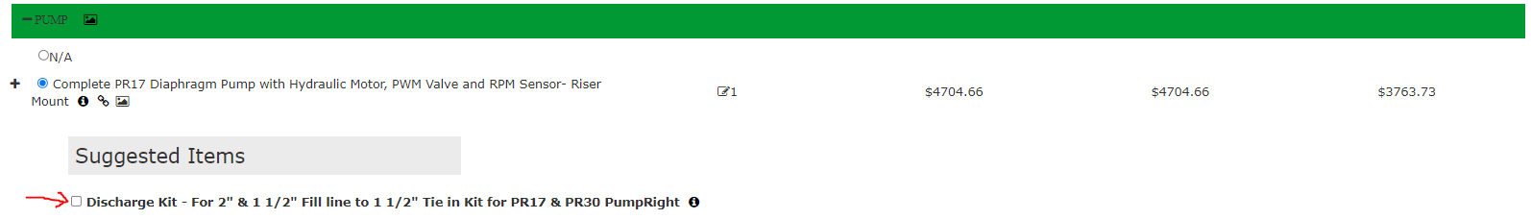
Suggested Items
Some items have Suggested Items associated with them. These are typically things that will be needed for a complete system but may be customer / dealer provided.
Upon selection of a parent item that has a suggested item, the Suggested Items section will automatically expand.
To add the Suggested Item to the quote, click the check box next to the item.

Slide 14
System Pricing
The total system price is displayed in the upper right corner of the screen.
To hide Dealer pricing, click the eyeball icon to the left of the System Total. The Dealer pricing will also be hidden when printing if the eyeball icon has been clicked.

Slide 15
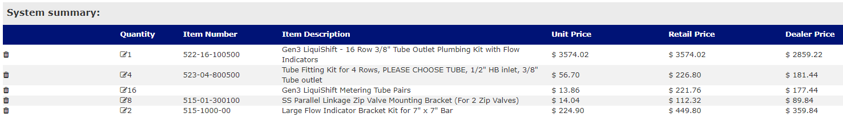
System Summary
As selections are made in the System Design section, a list will appear at the bottom of the page in the System Summary area.
Note that a small number of items are exclusive to the Build and Price Tool, and will not have an Item Number. Your SurePoint salesman will address these when the quote moves to an order (for example, metering tube sizing will be reviewed and calculated by your SurePoint sales rep, so a specific item number is not shown).
Items can be removed from the quote by clicking the trash can icon in the left-hand column. Deleted items will be shown crossed out, and pricing will adjust accordingly. Clicking the trash can icon again will add the item back to the quote.

Slide 16
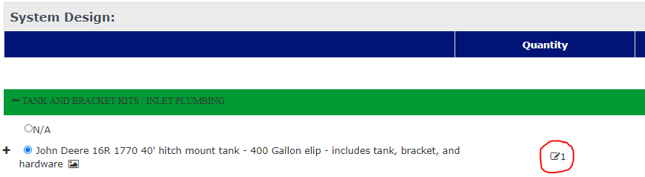
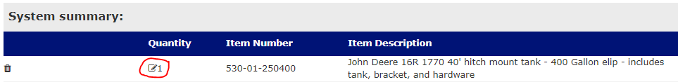
Editing Item Quantities
Item quantities can be adjusted by clicking on the quantity in either the System Design or System Summary section. It is only necessary to adjust it in one section or the other – quantities will adjust to match in the other section.

Slide 17

Saving the Quote
To save the quote at any time, click the orange Save Button in the upper right of the quoting page.
This will save the quote and assign a Configuration ID, and a dropdown menu will appear (dropdown options will be further explained on subsequent slides):
    Order Quote (we’ll cover this one last)
    Print Quote
    Email Quote
    Download Quote

Slide 18


Printing the Quote
Select Print Quote from the dropdown menu that appears on the quoting page after Saving.
This will bring up a print preview, and allow you to select printing options.
When the desired print options have been selected, press the blue Print button to print the quote.
As previously noted, the eyeball icon next to the System Totals on the quoting page can be clicked prior to printing to hide dealer pricing on the printout.

Slide 19

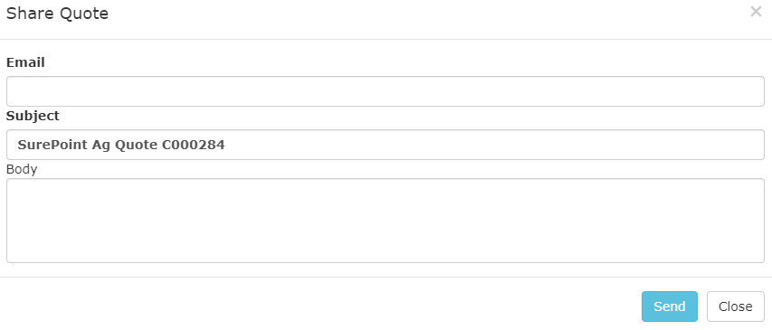
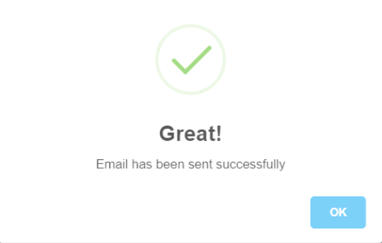
Emailing a Quote
Another option from the dropdown menu is to email the quote.
Selecting this will bring up the screen shown on the left below. Enter the email address and any relevant info in the fields provided, and then hit Send. Once sent, the screen on the right will pop up.

Slide 20

Downloading a Quote
Select Download Quote from the dropdown box to save a PDF of the quote.
It will take some time to download, and then the file will appear in your Downloads folder.

Slide 21
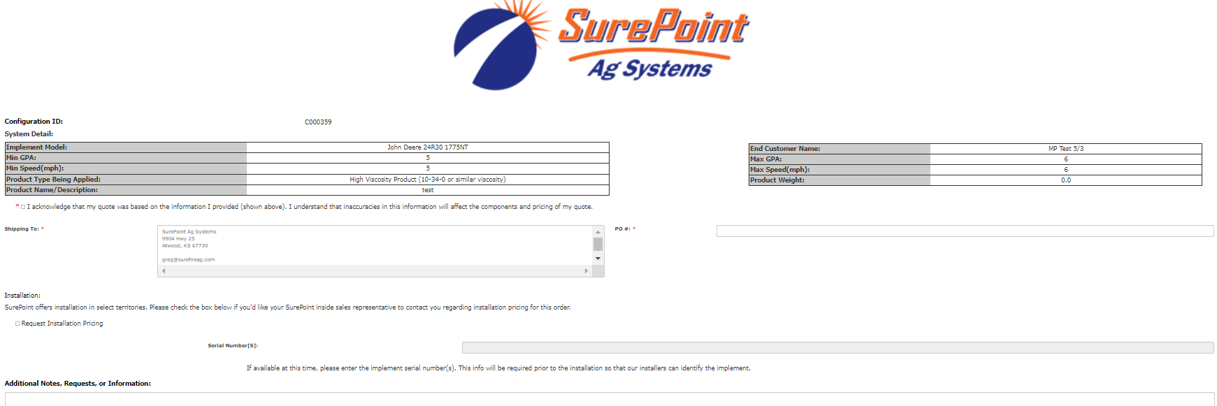
Ordering a Quote
Selecting “Order Quote” from the dropdown menu on the quoting page will bring up the order finalization page:

Slide 22
Instructions for the Order Finalization Page
Read the acknowledgement and check the box next to it.
Very the shipping address and make any necessary changes.
Enter a PO if known.
If installation pricing is desired, check the box and then provide implement serial number(s) if known. S/Ns are not needed if SurePoint will not be installing.
Add any additional notes in the space provided.
Click on the “Complete Order” button in the bottom right.
This will bring up a confirmation page (example on next slide).

Slide 23
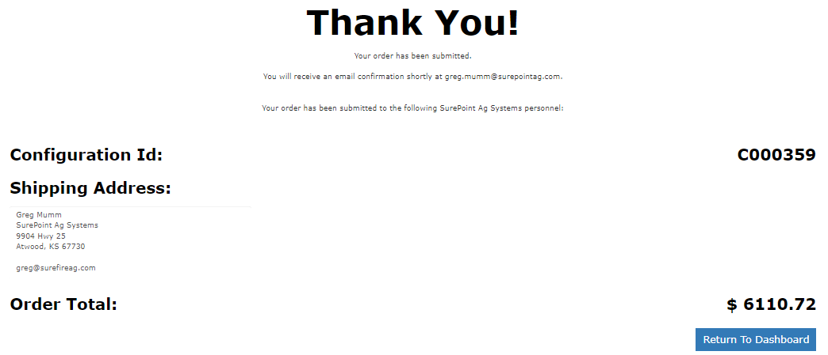
Order Confirmation Page (example)

Slide 24
SurePoint Ag Build and Price Tool Dashboard
Go to http://support.surefireag.com/front_quoting_page/ (must be logged in). This page can also be accessed by clicking the “Return to Dashboard” button on the Order Confirmation Page (discussed on previous slide).
This is the front page of the Build and Price Tool where we clicked the “Start New Quote” button at the beginning of this presentation. There are three sections on this page:
1. My Quotes – this is a list of your quotes that have not yet been converted to orders. Quotes will remain accessible for 60 days.
2. My Orders (In Process) – this table shows your quotes that have been converted to orders and are awaiting review by a SurePoint Ag sales representative.
3. My Orders (Finalized) – this table displays your orders that have been reviewed and processed by a SPA sales rep.
The icons that appear in the right-hand column of the three tables will be explained on the next slide

Slide 25
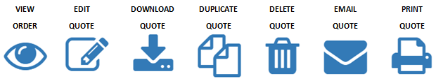
View Order – view the components on an order as well as the information that was entered. Orders are not editable.
Edit Quote – view a quote you’ve worked on previously and edit if necessary. Be sure to hit Save when done.
Download Quote / Order – download a PDF of the quote / order
Duplicate Quote / Order – this will start a new quote with the information that was entered on the original quote. Can be used to make an exact duplicate, or to make a variation of a previous quote. Components will need to be selected again.
Delete Quote – delete the quote and remove it from the list
Email Quote / Order – allows the quote / order to be emailed out
Print Quote / Order – prints a paper copy of the quote / order

