Slide 1
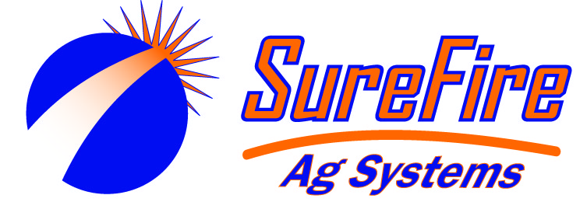
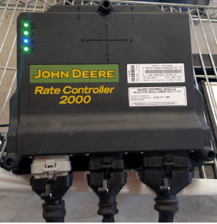


Slide 2
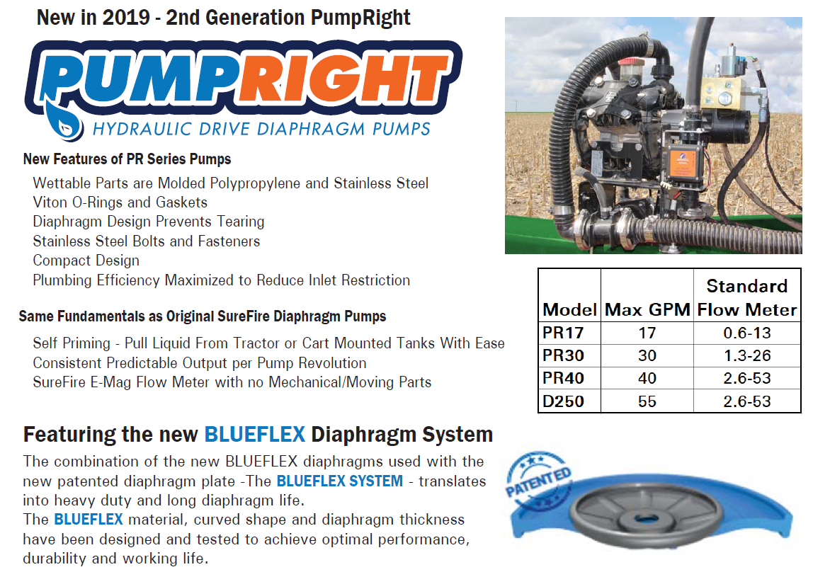

Slide 3
The PumpRight Difference
Can be mounted anywhere, no need to be close to tank source
Can run dry without damaging the pump
Compensates for speed changes
Ideal for low and high rate applications
Can handle system pressures up to 100 PSI
Easy to maintenance if needed – videos available for servicing
Three to six chambered pumps create smooth output per pump revolution
Can run a flat rate or variable rate without having to make any pump adjustments
Multiple hydraulic plumbing combinations with low oil consumption to prevent the “I’m out of hydraulics” comment

Slide 4
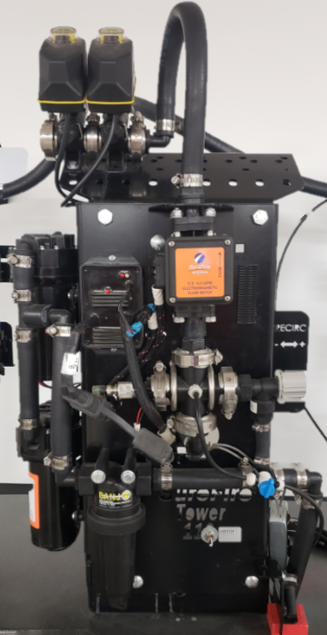
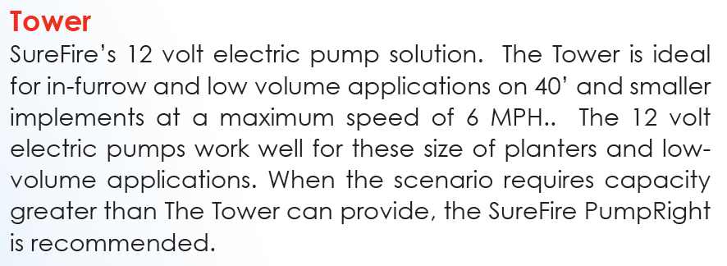

Slide 5
The Tower Difference
Comes fully assembled with good mounting solutions
Ideal for low flow systems and are designed for them
Compensates for speed changes
Change rates without having to mechanically adjust the pump
Controlled by PWM EPD
Improved internal diaphragms to hold up better to fertilizer and chemical application
Works best under 5 GPM, under 30 PSI, and under 60’ of EPD extension
Tower 110 or 200 max flow @ 6 MPH (SureFire Recommendations)
  20 foot – 18 gallon/acre
  30 foot – 11-12 gallon/acre
  40 foot – 8 gallon/acre
  *** Tower systems need to be close to the tanks they pull from. If pulling long distances the PumpRight is needed.

Slide 6
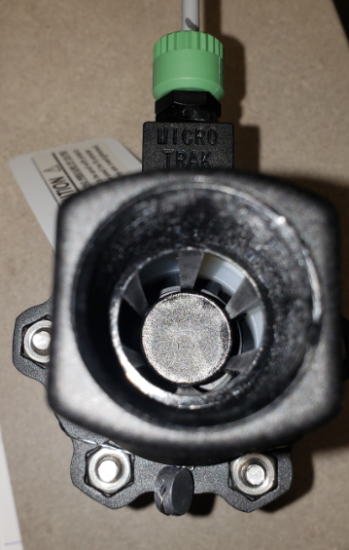
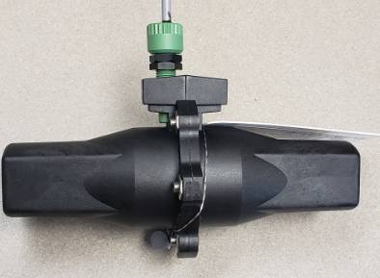
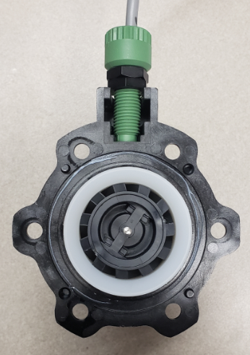
A common approach by others is to use a turbine flow meter. These components live with some universal truths
Lower cost initially
First day in the field will likely be its best day ever
Susceptible to wear
Mechanical parts = jamming especially small flow meters
Remember particulates & slime
Requires calibration with changing viscosities and wear to maintain accuracy

Slide 7
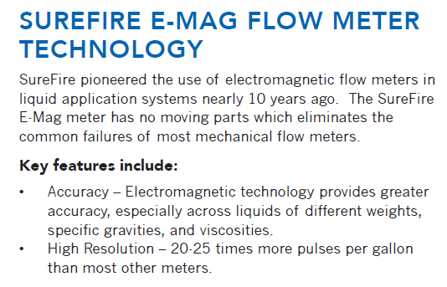
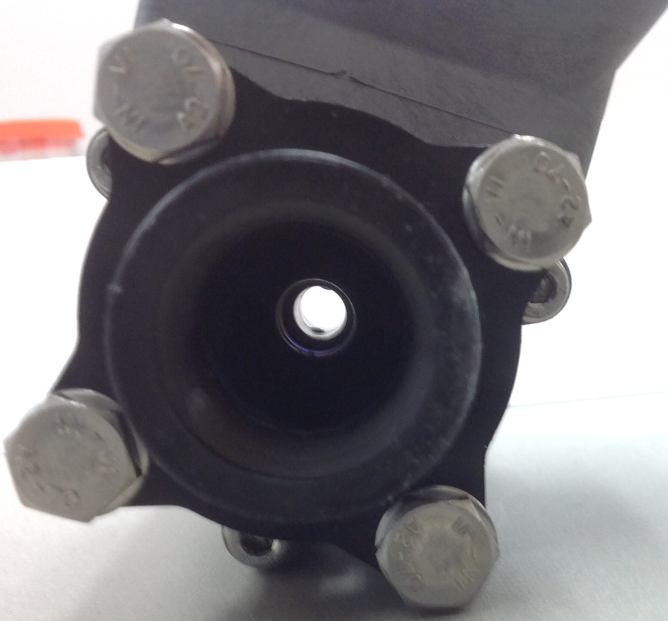
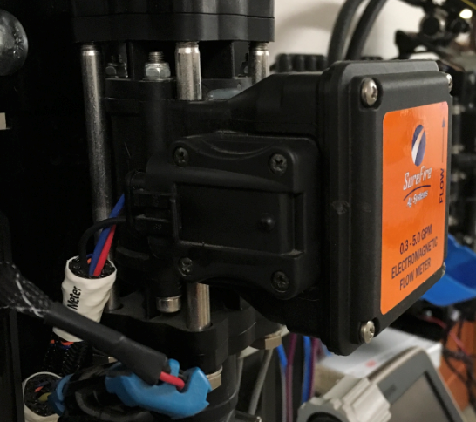
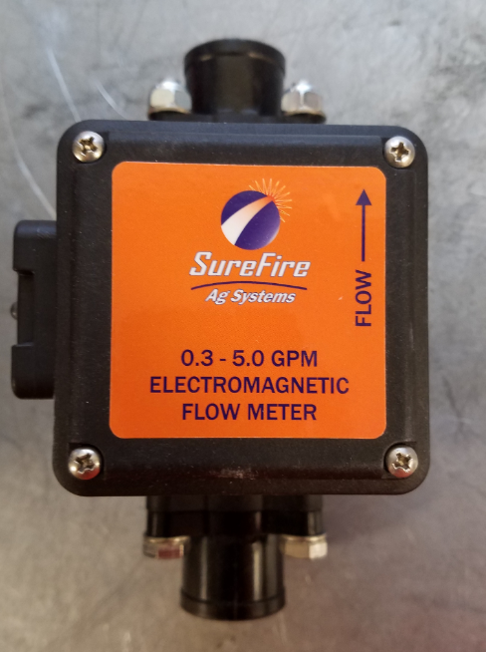
SureFire E-Mag Flowmeter Technology
SureFire promoted the use of electromagnetic flowmeters in liquid application systems nearly 10 years ago. The SureFire E-Mag meter has no moving parts, which eliminates the common failures of most mechanical flowmeters.
Key features include:
Accuracy—Electromagnetic technology provides greater accuracy, especially across liquids of different weights, specific gravities, and viscosities.
High Resolution—20-25 times more pulses per gallon than most other meters.

Slide 8
The E-Mag Difference
No moving parts
No need to take apart and clean internal components
Accurate out of the box – within 3% accuracy and remains consistent with changing viscosities
  For most people, the flowmeter is accurate enough out of the box. To fine tune the flowmeter further, SureFire recommends you perform a catch test on multiple rows or compare total volumes against scale tickets.
Able to hit very low flow rates with enough resolution to maintain system accuracy - ideal for section-controlled systems as well
  We’ve configured systems down to an ounce per minute per row

Slide 9
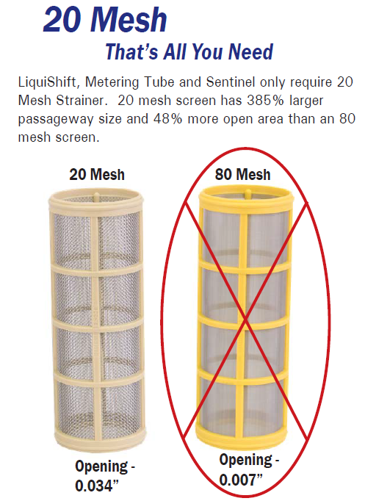
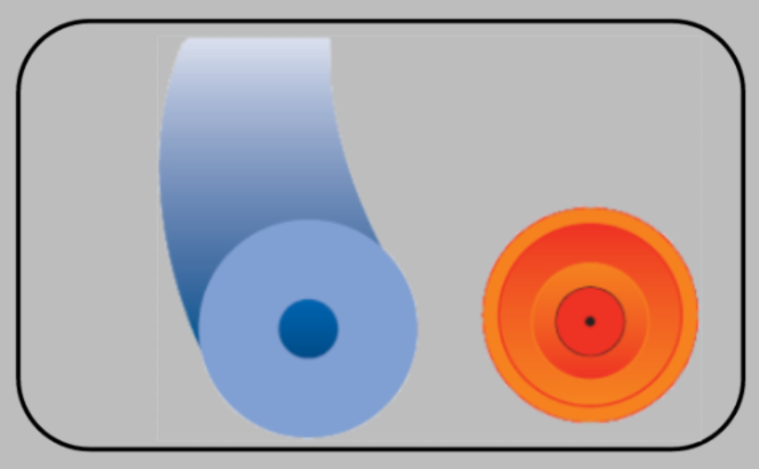
“I was driving through the field and my rate just dropped to zero. When I take off again it works for a while then drops off again. What’s wrong?”
With our E-Mag flow meter and a 20 mesh filter, this can change the dynamic of applying liquid fertilizer

Slide 10
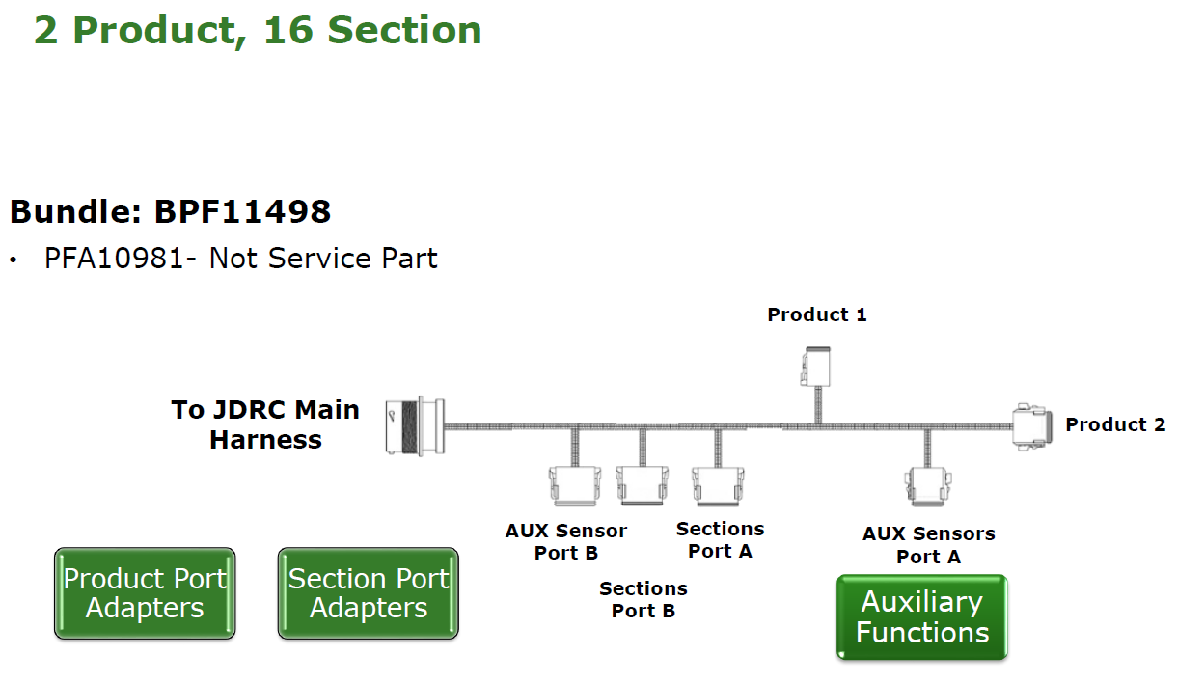
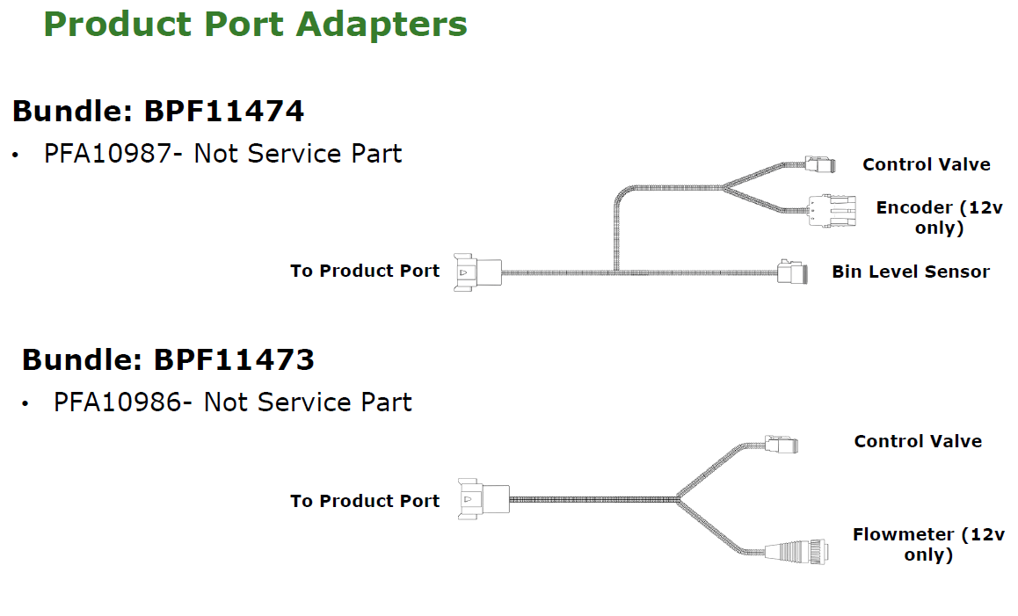
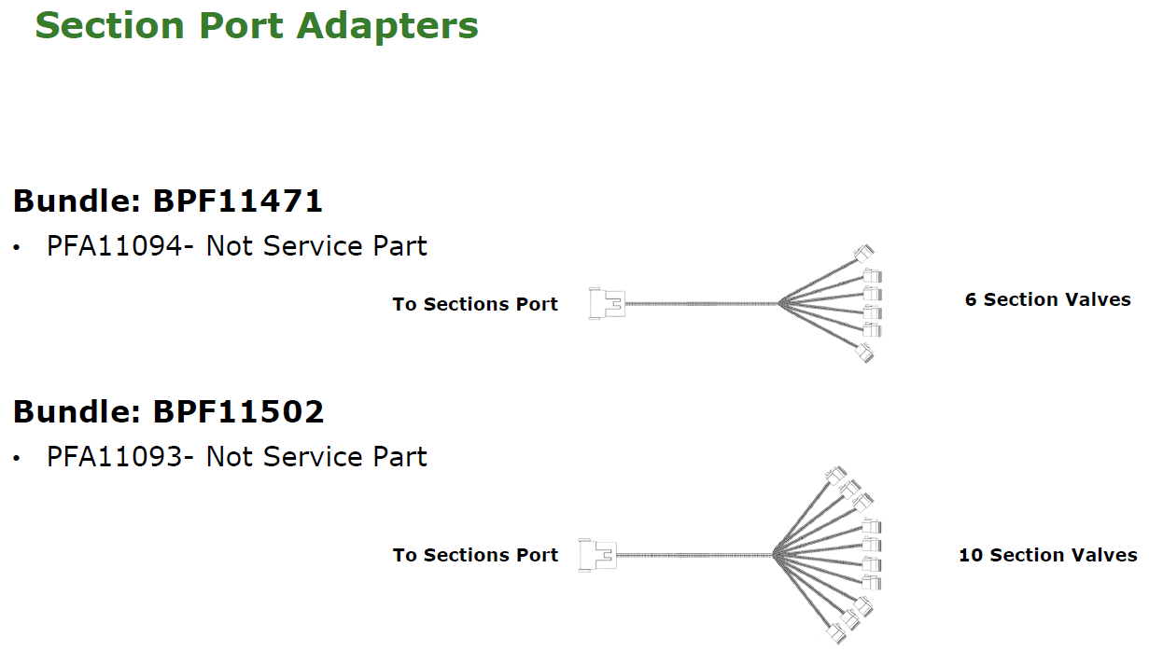
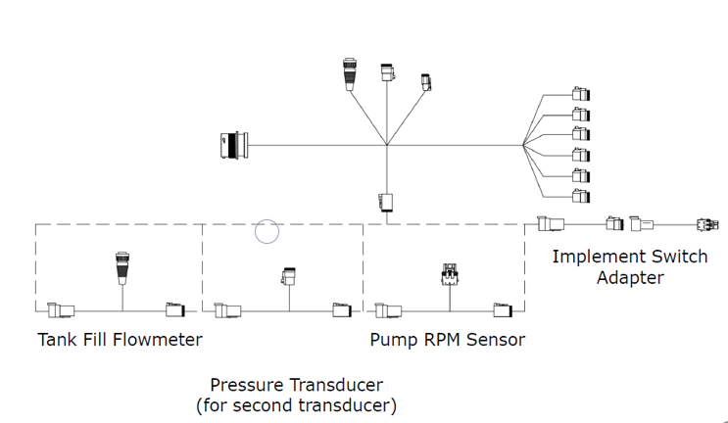

Slide 11
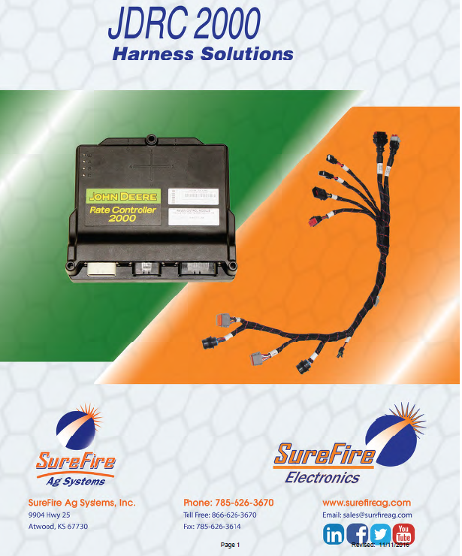
SureFire harnessing is designed specifically and primarily for SureFire systems. It may need to be modified when hooking to other systems on the market.

Slide 12
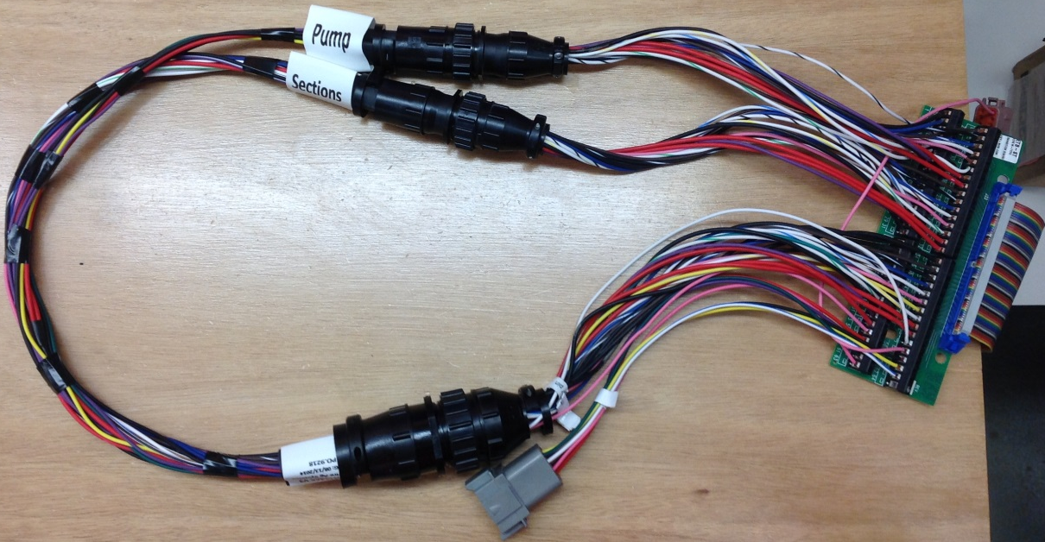
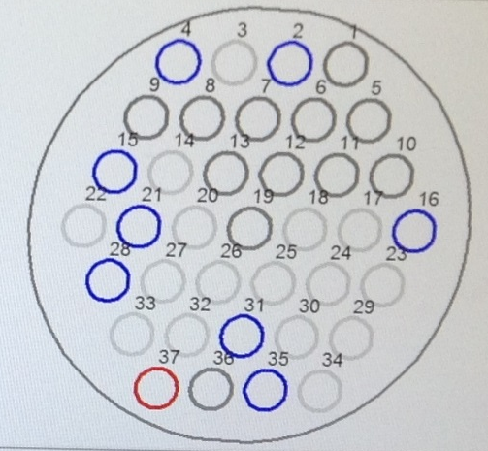
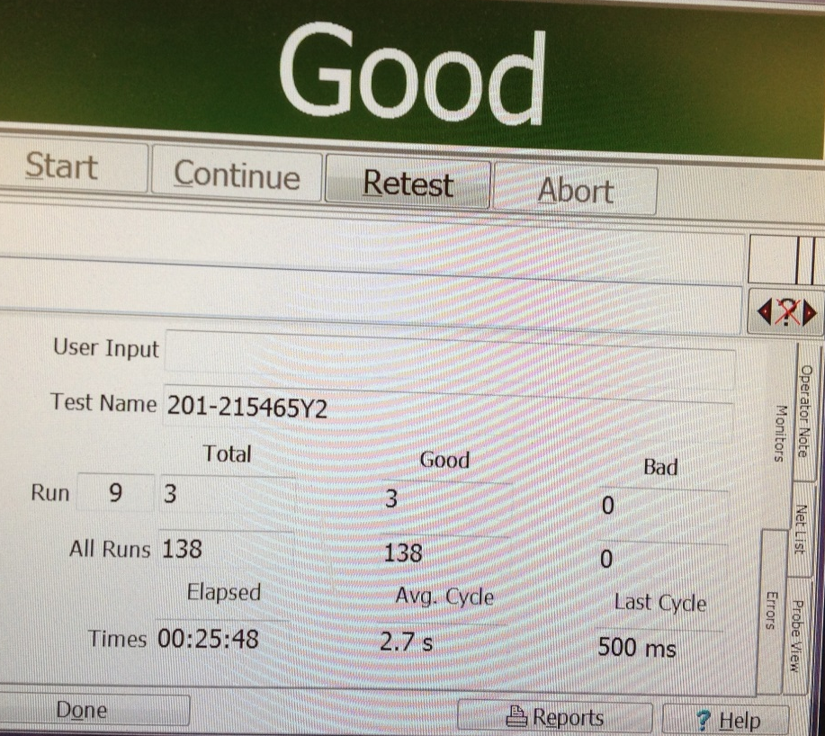
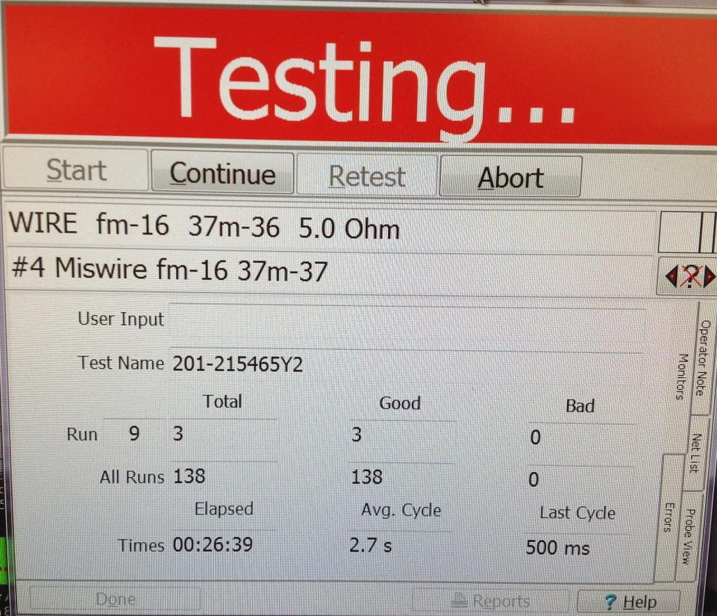
SFE Harness Testing

Slide 13
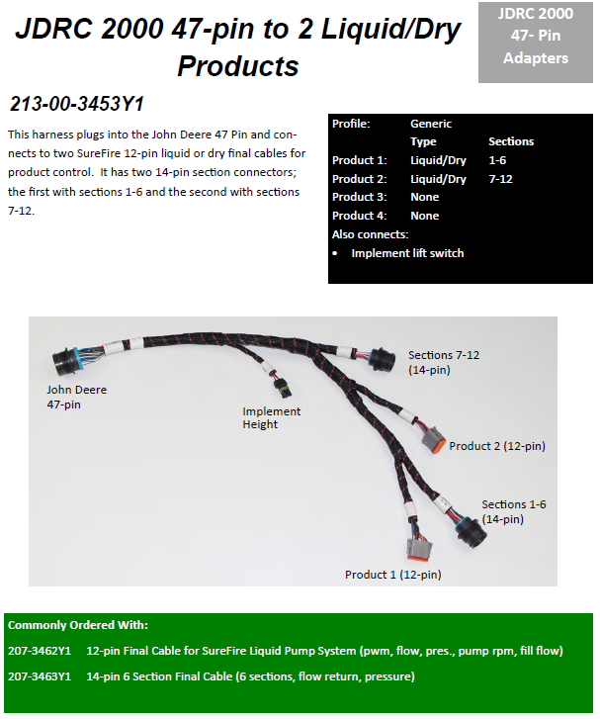

Slide 14
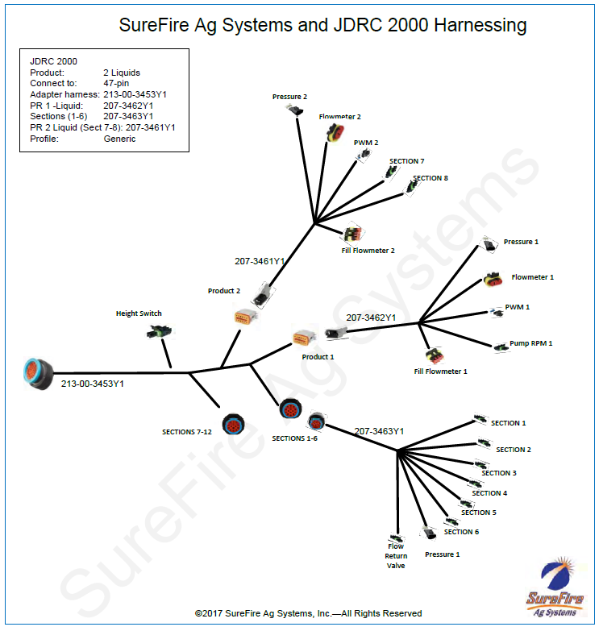

Slide 15
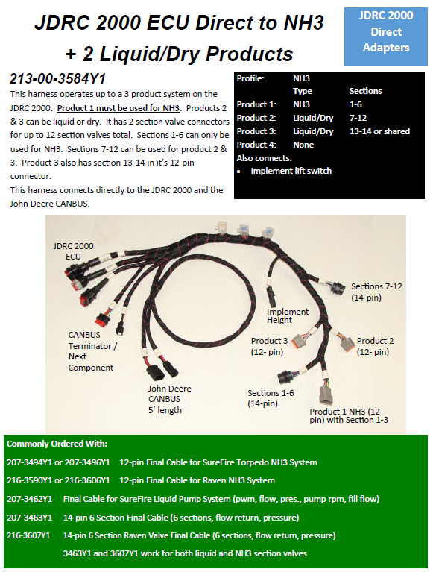
Many Different Possibilities-we have solutions

Slide 16
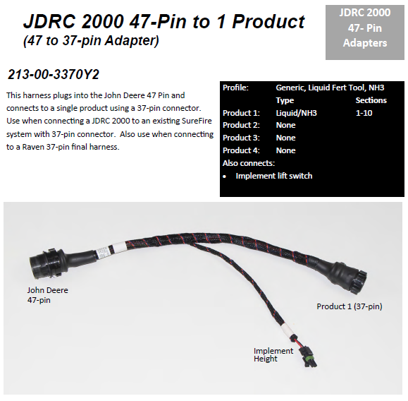

Slide 17
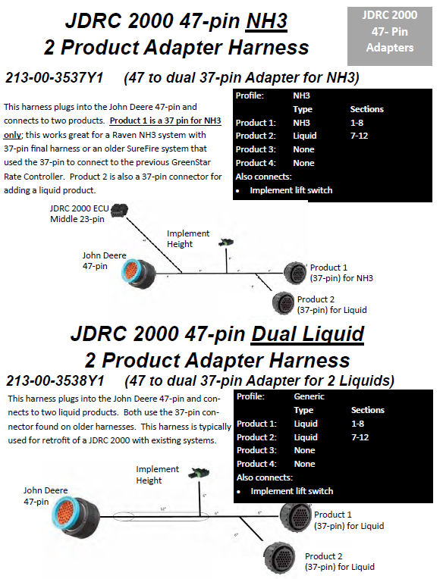

Slide 18
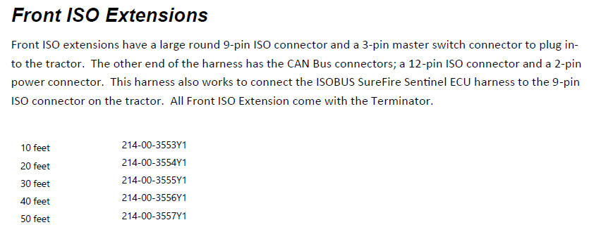
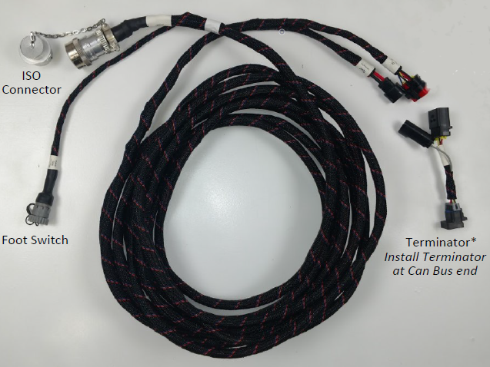

Slide 19
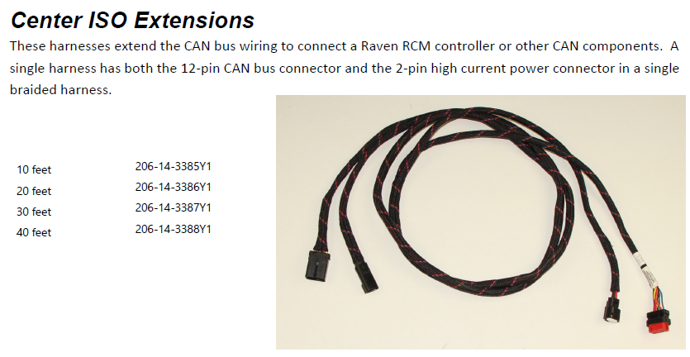

Slide 20
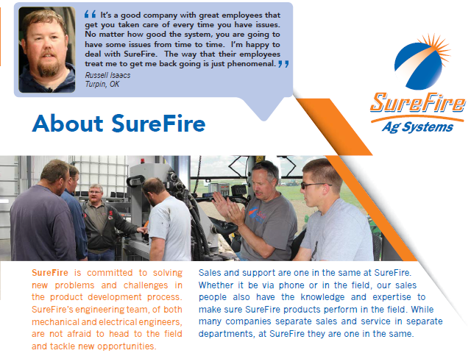

Slide 21
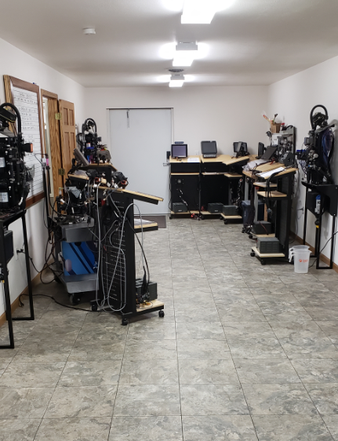
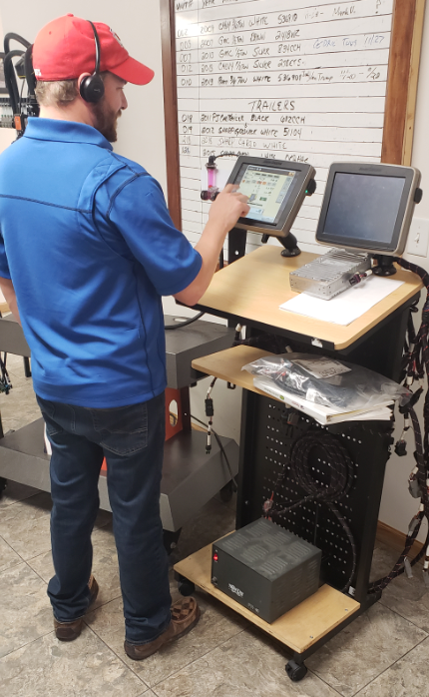
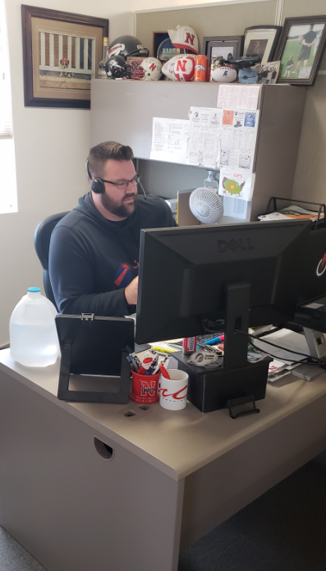

Slide 22
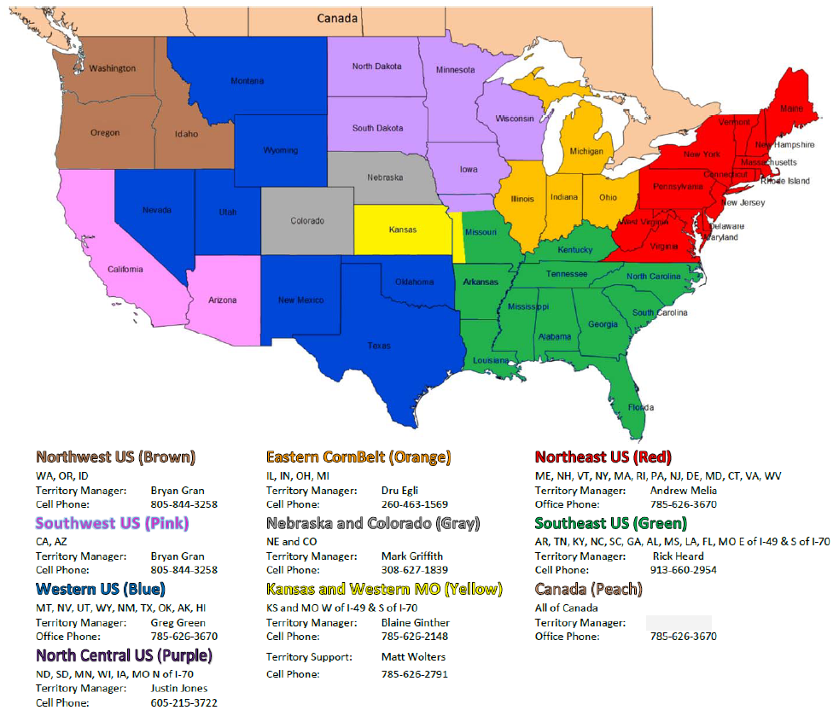

Slide 23
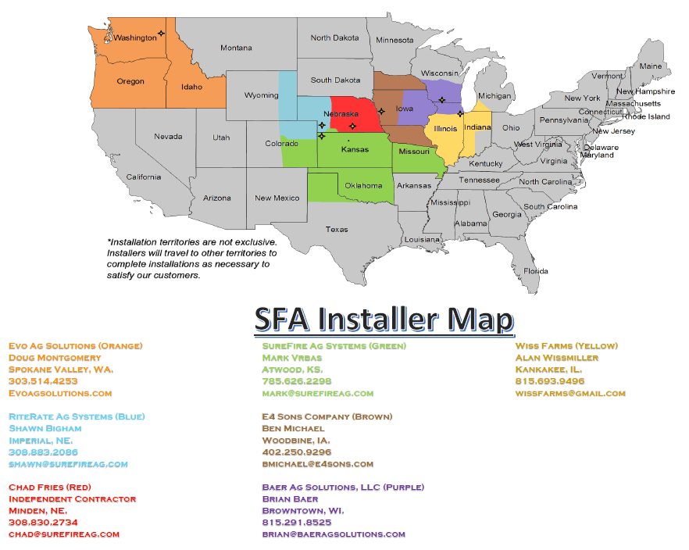

Slide 24
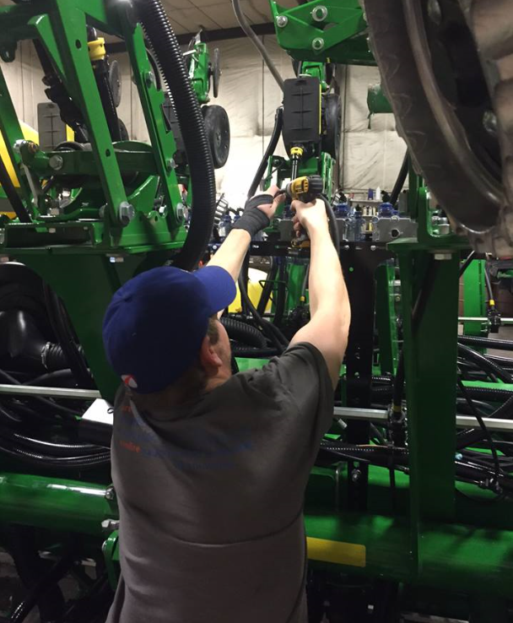
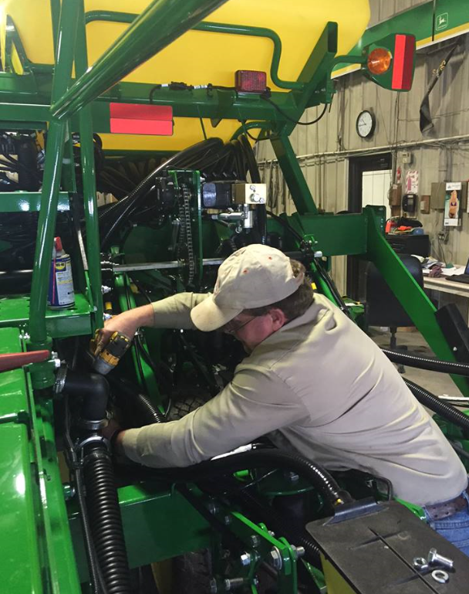
SureFire installs save on your shop time by letting us do what we’re good at with no hidden costs, set install rates, and timely installs.

Slide 25


